Slide 1
Capgemini Case Study
TOPIC -
“Online Railway Reservation System”
Capgemini Mentors -
Amit Bhave
Gaurav Pednekar
TIT College Mentors -
Manoj Tyagi
Reena Sarathe
Presented by
Adarsh Patel (Group 1)

Slide 2
Contents
Introduction
Scope of Project
Problem Definition
Objectives
Methodology
Software & Hardware Requirement
Proposed Work
Application & outcomes of Project
Conclusion
Limitation & Future Scope
References

Slide 3
Introduction
This system is designed for the online reservation of railway tickets for travel between any source and destinations which is a part of Indian Railway network.
This system enables the passenger for Advance booking in any class, a maximum of Five berths/seats at a time, for journey between any two stations served by a train.
It also provides details about - Time table, Train fares, Current status of reservation position, Train available between a pair of stations.
It also allows the passenger to cancel their ticket and for the Admin to Manage trains.

Slide 4
Scope of Project
It can help in Railway reservation and management. In less time, it can help the administrator get all the booking details of the passengers.
It will help a person to know the management of the past year perfectly and vividly.
It also helps in current all works related to railway reservation system.
It will also help in reducing the cost of railway reservation management by digitalizing the process.

Slide 5
Proposed System
The aim of the proposed system is to develop a system of improved facilities. The proposed system can overcome all the limitations of the existing system. The system provides proper security and reduces the manual work.
Security of data.
Ensure data accuracy’s.
Minimize manual data entry.
Minimum time needed for the various processing.
Greater efficiency.
Better service.
User friendliness and interactive.

Slide 6
Problem Definition
The offline ways to do ticket booking takes much time for the passengers, because they have to stand in long queues, and there is more manual work.
Railway Administrators may also find it difficult to manage trains because of the complex softwares they use.

Slide 7
Objectives
The purpose of this project is to describe the railway reservation system which provides the train timing details, reservation, billing and cancellation on the reservation.
• Confirm reservation by Booking.
• Cancellation of Tickets.
• Online reservation.

Slide 8
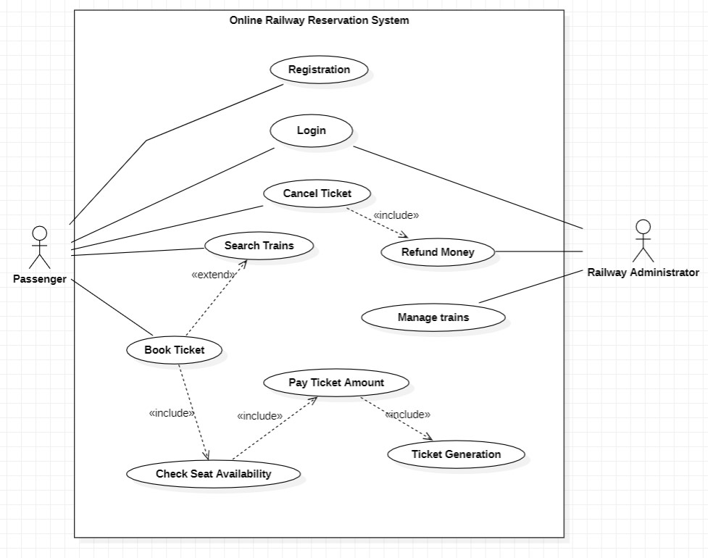
Methodology
Functional overview:

Slide 9
Software & Hardware Requirement
FRONT-END
HTML
CSS
JavaScript
BACK-END
Spring BOOT
JPA Hibernate
PostgreSQL Database
Spring Security

Slide 10
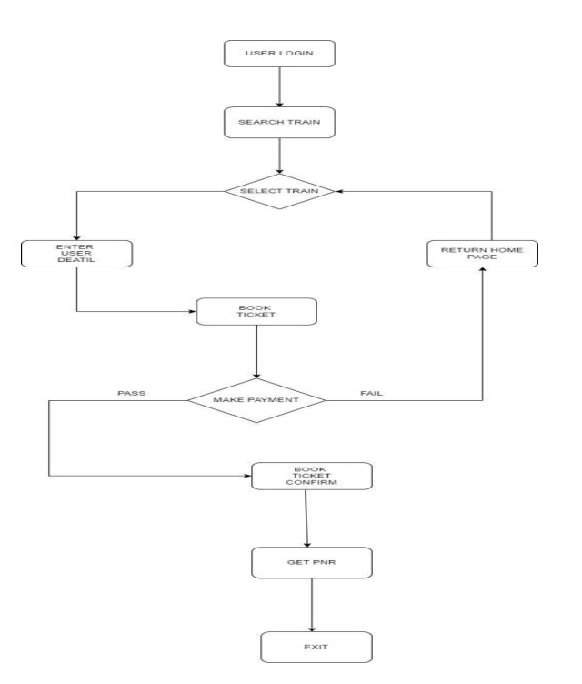
Proposed Work
Data Flow Diagram:

Slide 11
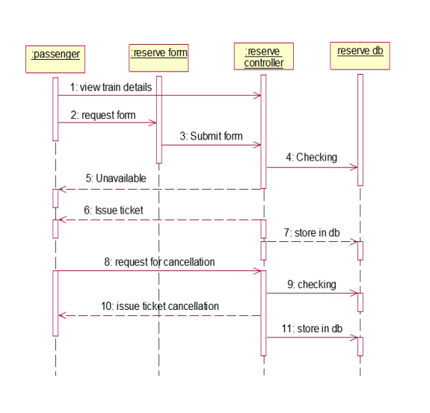
Application & outcomes of Project
Sequence Diagram :

Slide 12
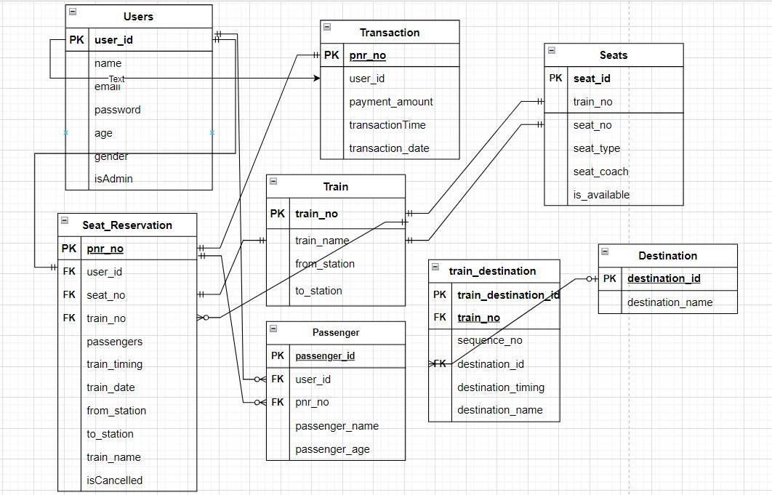
ER Schema Diagram

Slide 13
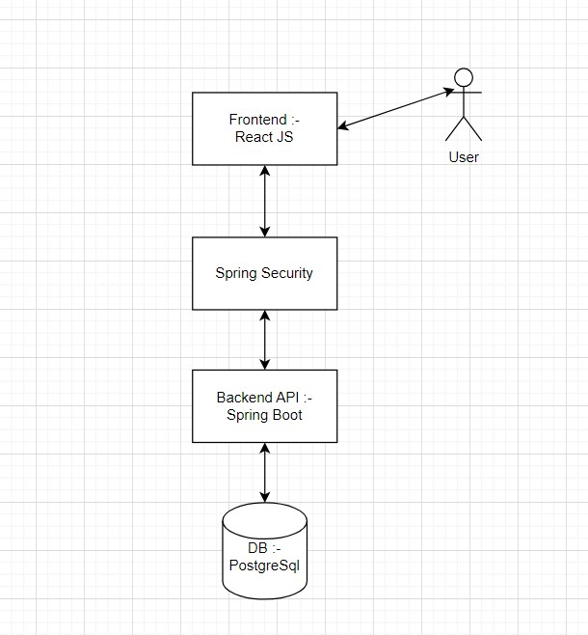
Project Architecture Diagram

Slide 14
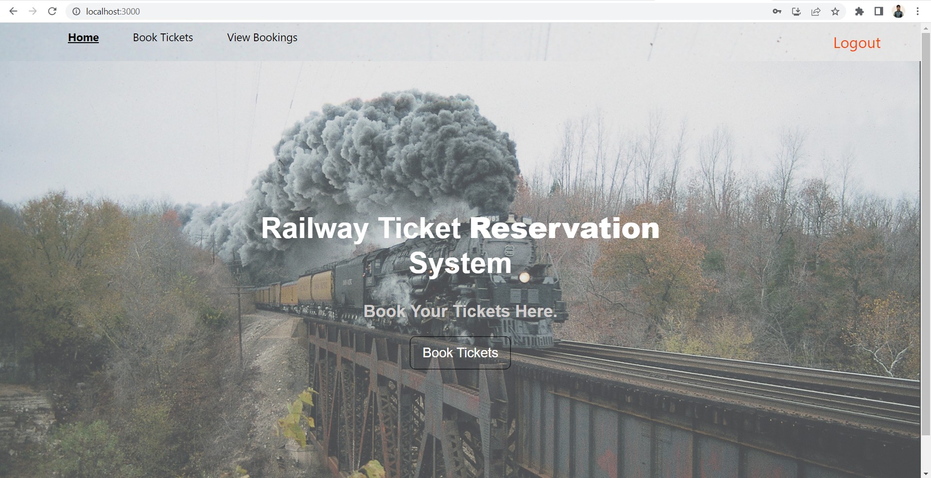
Front end screen shots
Home Page :

Slide 15
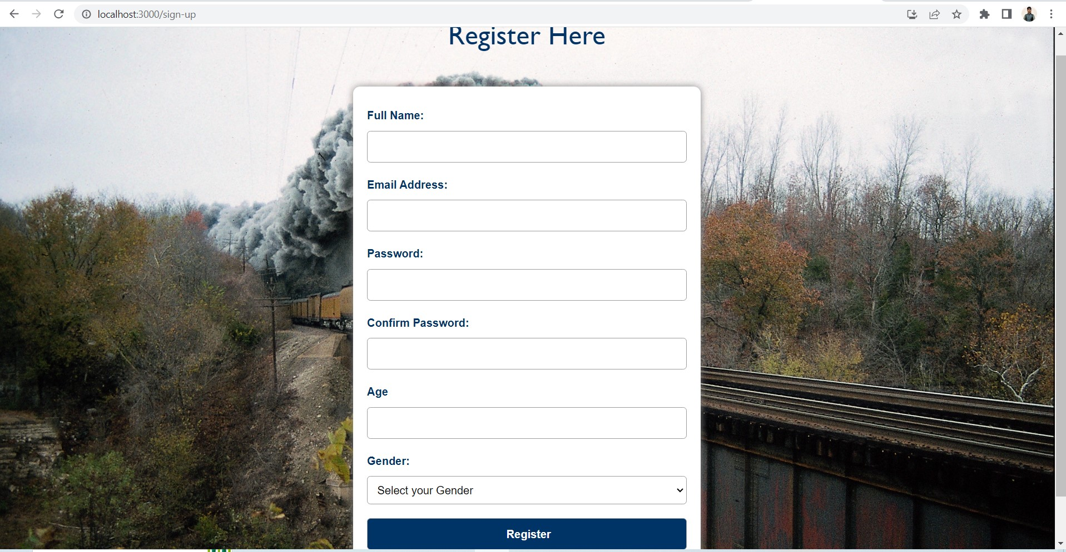
Front end screen shots
Sign Up Page :

Slide 16
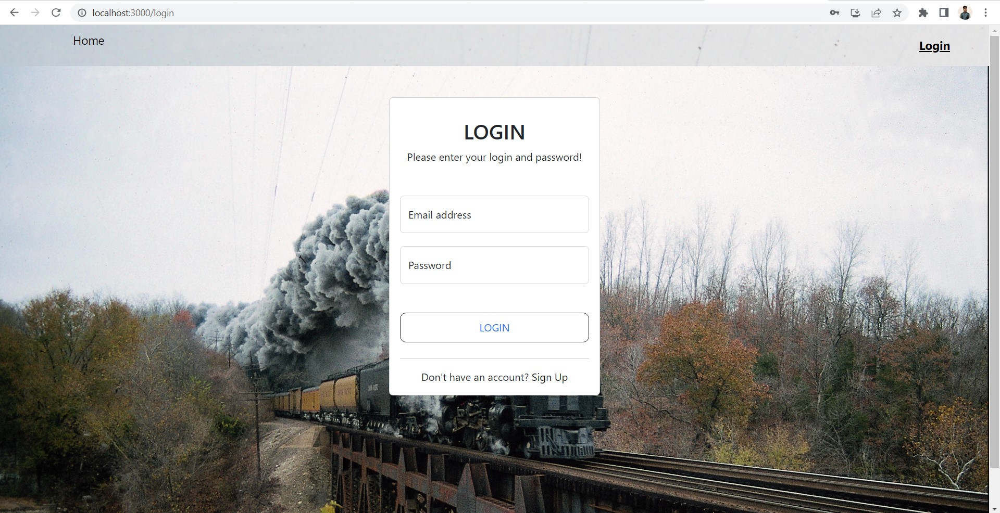
Front end screen shots
Login Page :

Slide 17
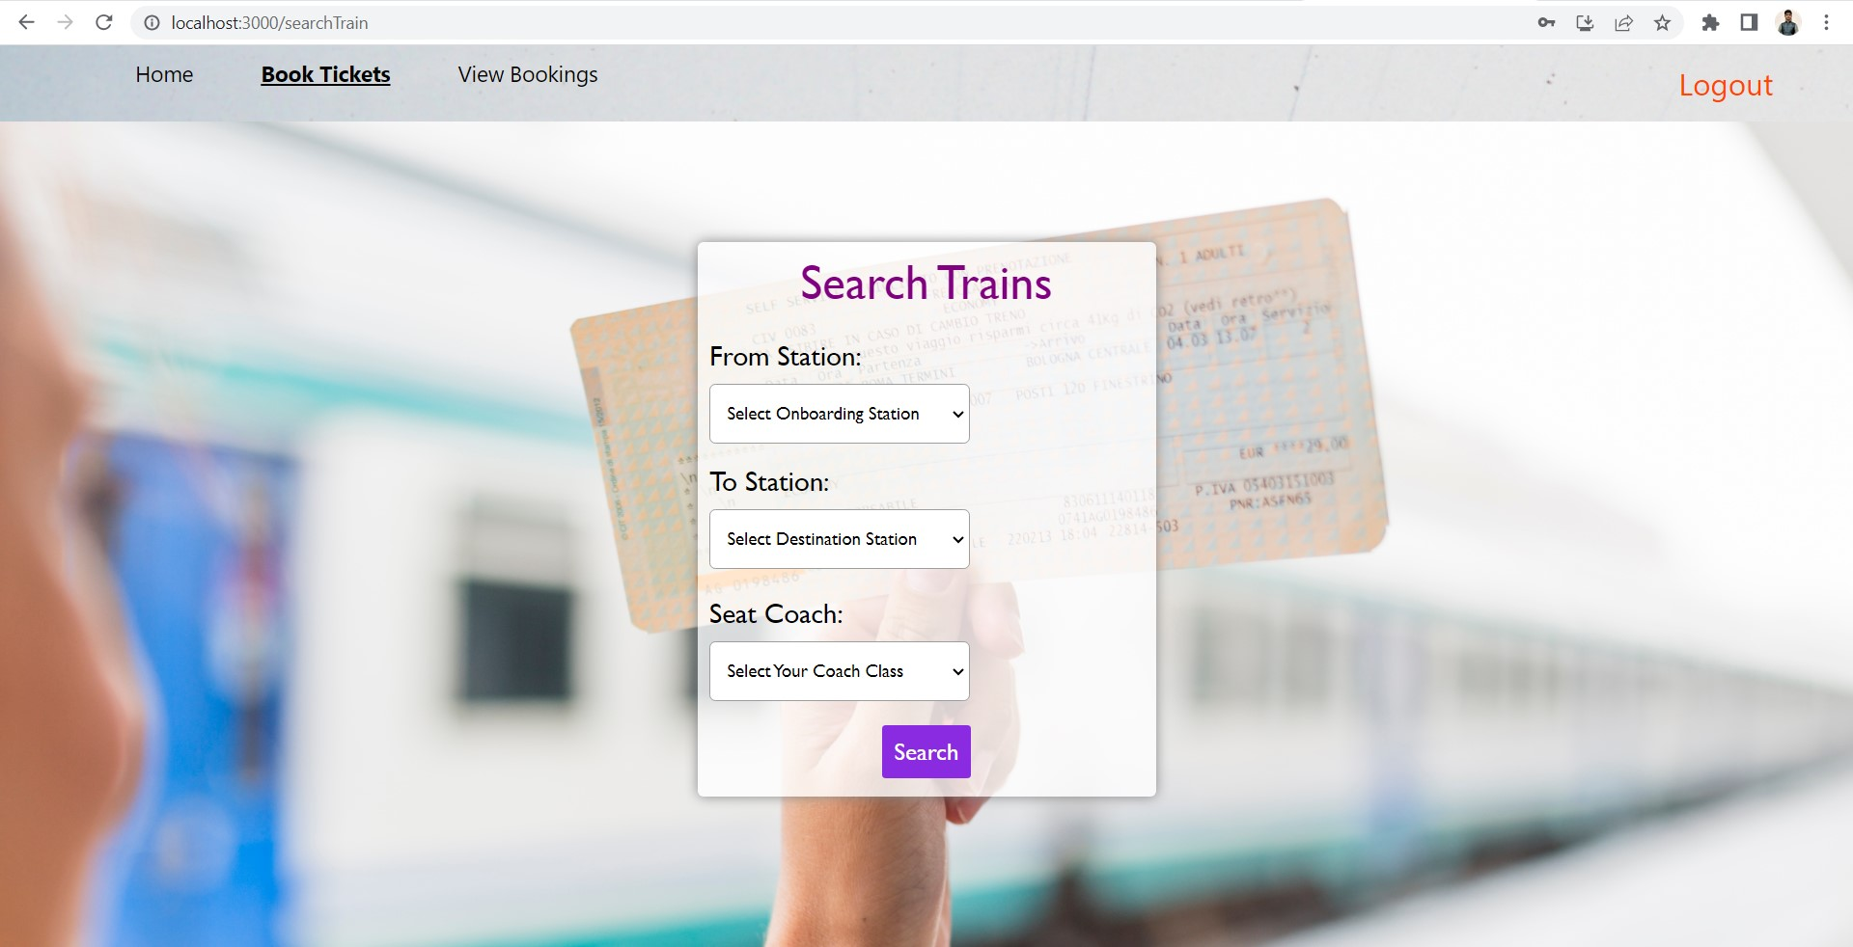
Front end screen shots
Search for trains Page :

Slide 18
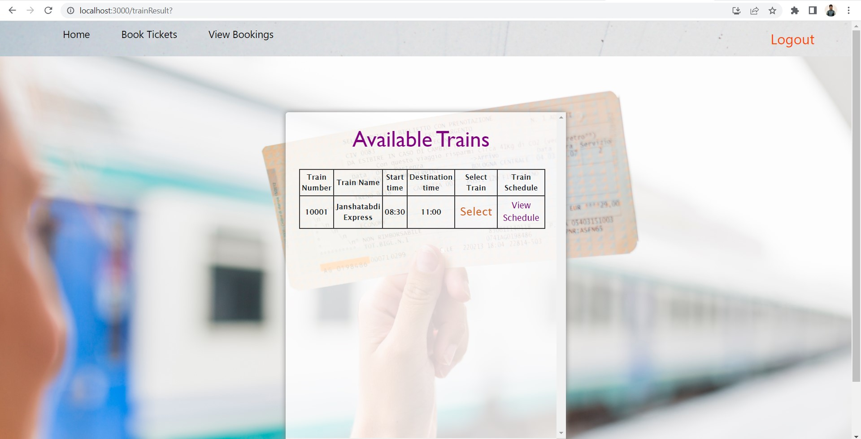
Front end screen shots
Available Trains Page:

Slide 19
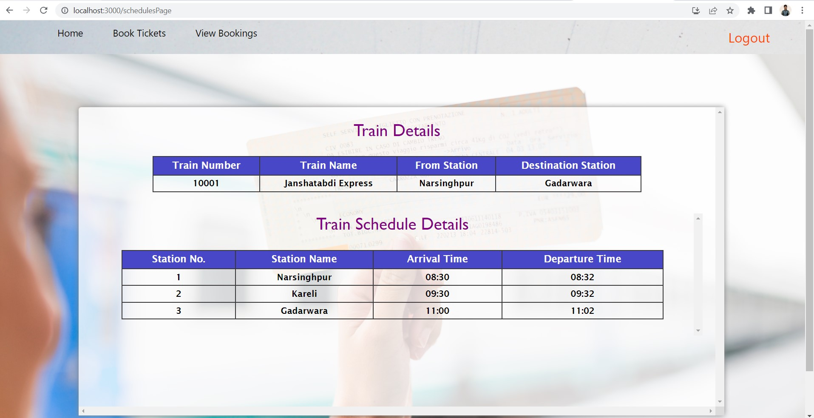
Front end screen shots
View Schedule Page

Slide 20
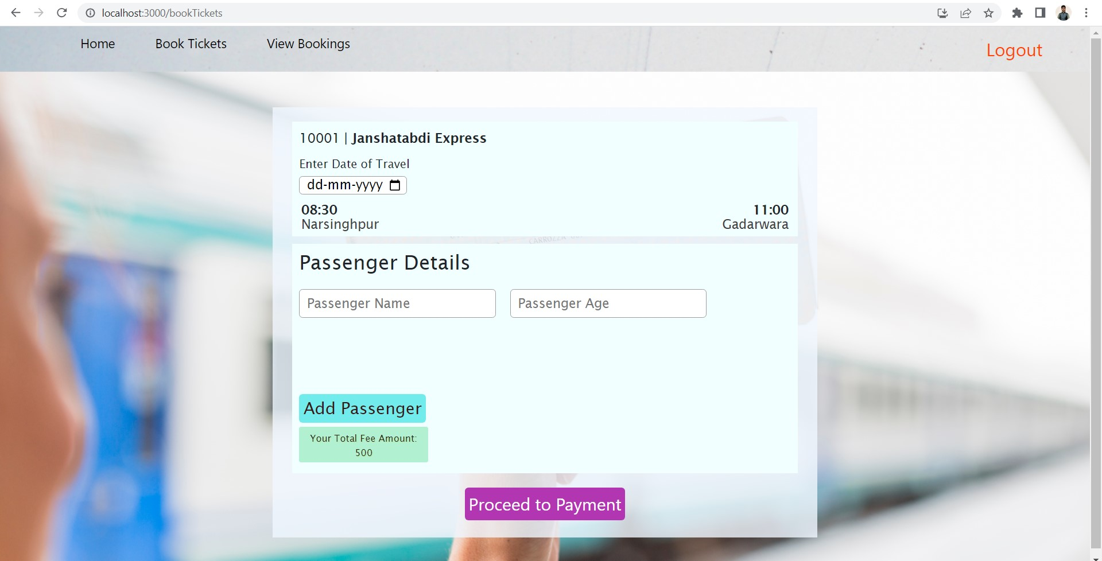
Front end screen shots
Confirm Booking Page

Slide 21
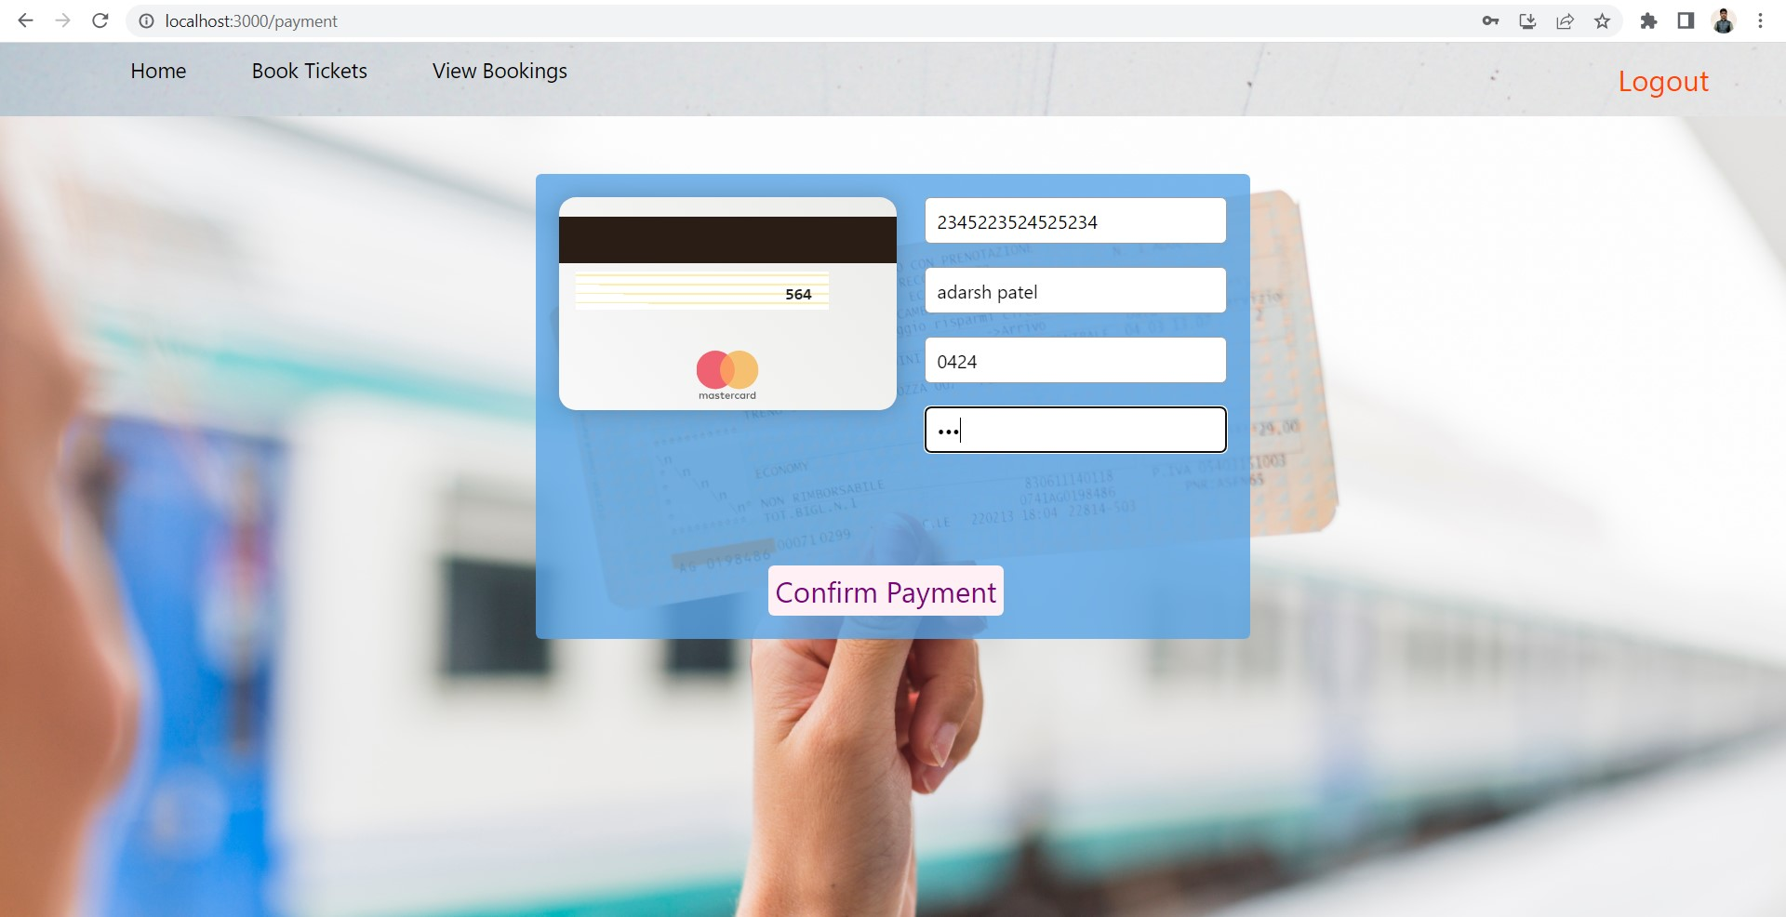
Front end screen shots
Payment Page

Slide 22
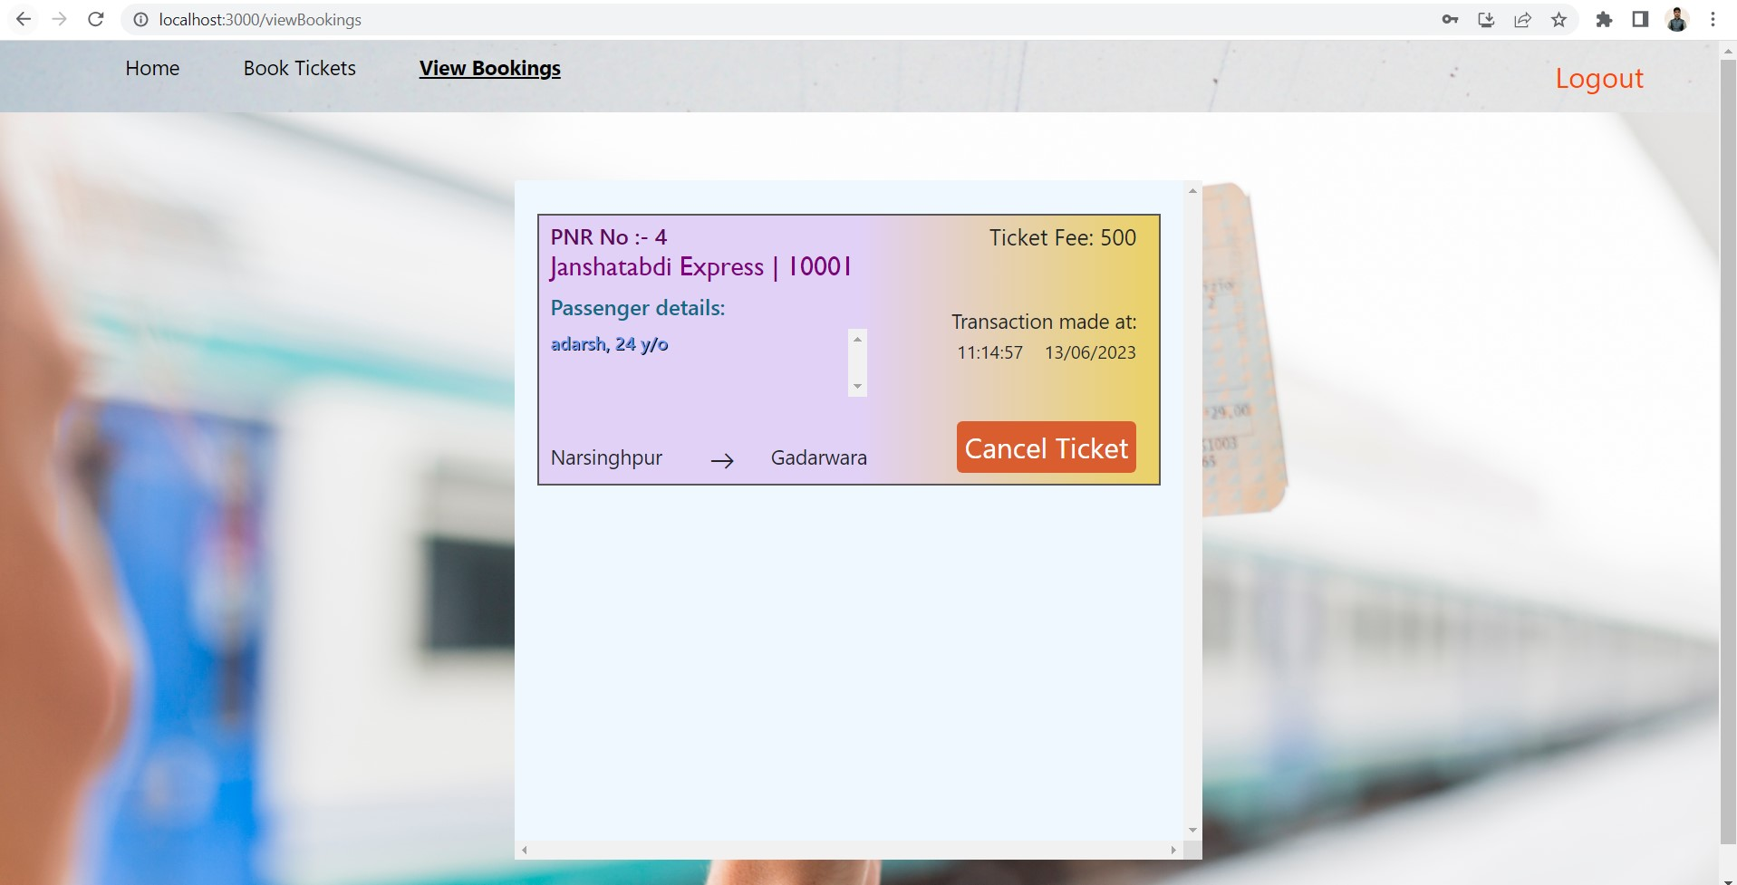
Front end screen shots
View Bookings Page

Slide 23
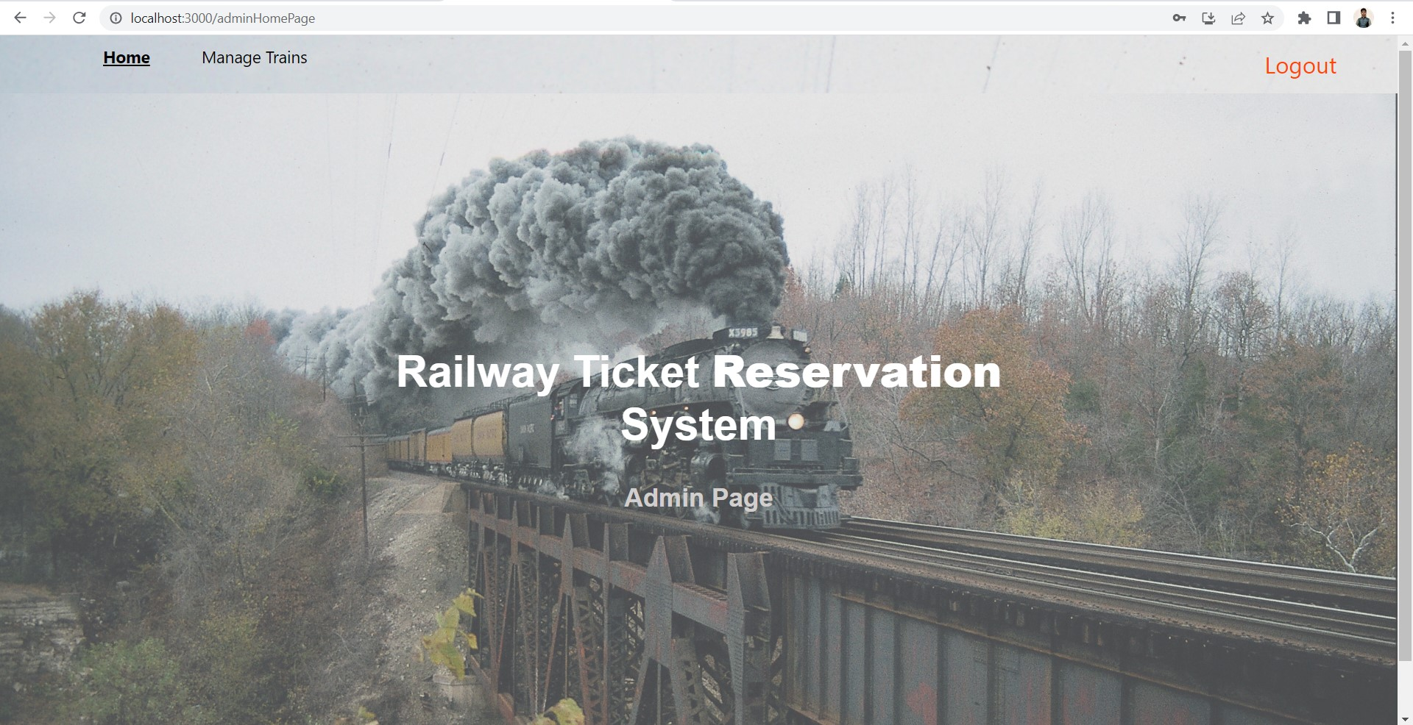
Front end screen shots
Admin Home Page

Slide 24
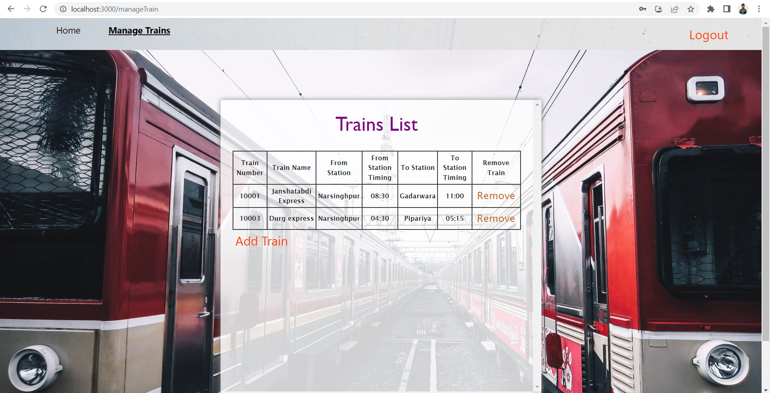
Front end screen shots
Admin Manage Trains Page

Slide 25
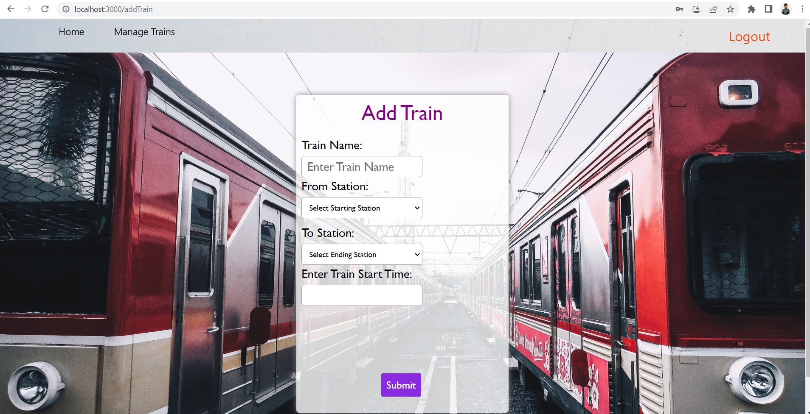
Front end screen shots
Admin Add Train Page

Slide 26
Conclusion
In our project Railway reservation system we have stored all the information about the Trains scheduled and the users booking tickets and even status of trains, seats etc.
This data base is helpful for the applications which facilitate passengers to book the train tickets and check the details of trains and their status from their place itself it avoids inconveniences of going to railway station for each and every query they get.
We had considered the most important requirements only, many more features and details cand be added to our project in order to obtain even more user friendly applications.
These applications are already in progress and in future they can be upgraded and may become part of amazing technology.

Slide 27
Limitation & Future Scope
Limitations of this project:
Not on large scale now
Not accurate every time.
Advantages of this project:
The online reservation system is a very good feature, because standing in Queues all the time and jostling away wasting your time is not the best thing to do, so the Online Railway Reservation website does help a great deal to book your tickets.
This project has very simple UI, so the passengers can easily book their tickets without getting confused.

Slide 28
References
https://github.com/
https://www.geeksforgeeks.org/
https://www.youtube.com/

Slide 29


